Slide 1


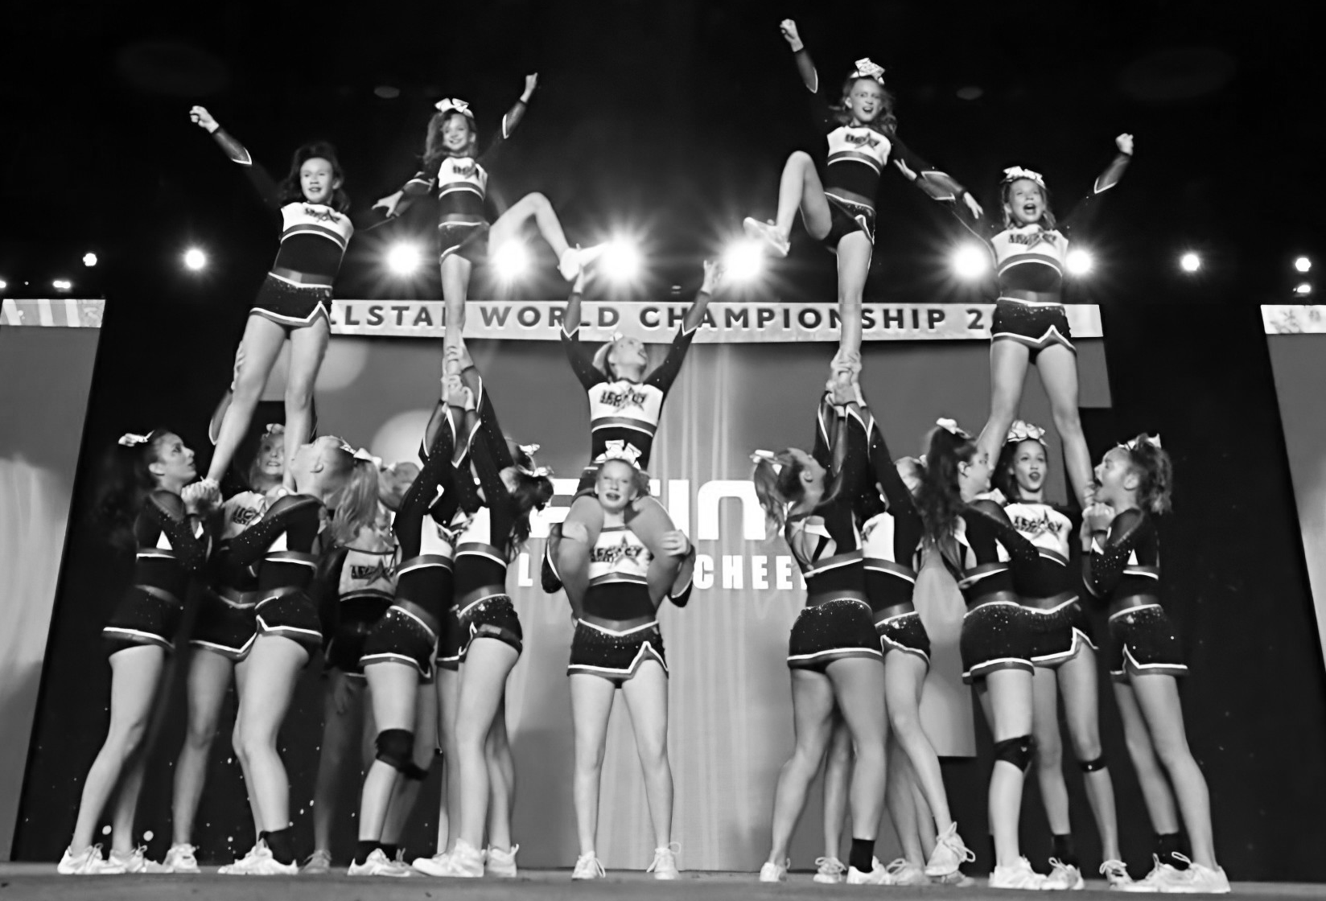
2025-2026 Legacy Class Handbook

Slide 2
Trimester of Classes
You may choose a payment plan or pay in full. The payment plan will be on autodraft. You are signing up for the entire Trimester, so there are no cancellations.
If new member, $50 registration fee
Trimester 2: January 5-May 22
  19 weeks
  $425 total, with $100 deposit to reserve a spot. Can be broken into 3 payments after deposit or paid in full.
Trimester 3: Summer!

Slide 3
Policies and Expectations
Please wear t-shirts or tank tops, but no crop tops/sports bras with shorts. Cheer tumblers wear shoes when they tumble. Hair in a ponytail. No Jewelry.
Stay in lobby or specified stretching area until coach comes to get you for practice.
Phones and backpacks to be left in lobby cubies. Water bottles may stay in the designated water bottle station. No food in gym area.
Makeup policy- if an athlete misses a class, they may makeup a class of comparable skill level. Just show up and sign in with the date missed. Makeups do not carry over seasons.
All athletes must be potty trained or have a parent in the lobby to take care of toiletry.
Classes with under 5 girls may need to combine and shift schedule.
Athletes will be assessed throughout the year, and may be encouraged to move up a class.

Slide 4
Class Description
Progressions- all athletes are expected to have strong fundamental knowledge of the proper skills progressions to start working at the next level.
Preschool age
Pre-tumbling- work on fundamentals of tumbling, movement, rolls, cartwheels hand stands
Basic 1- back bend kickover, hand stand limber, cartwheel,
Basic 2- walkovers, roundoffs,
Back Handspring- standing and running back handsprings.
Series- standing and running back handspring series
Tucks- standing and running back tucks
Layouts and Up- Layouts, Arabians, Fulls
Acro- Walkovers, Aerials, Handsprings as main focus

Slide 5
Agreement to Legacy Cheer Policies
I have read and agreed to the terms, conditions and policies set forth in the Legacy Cheer Program Packet.
_______________________
Parent Signature
_______________________
Date
_______________________
Athlete Signature

