Slide 1


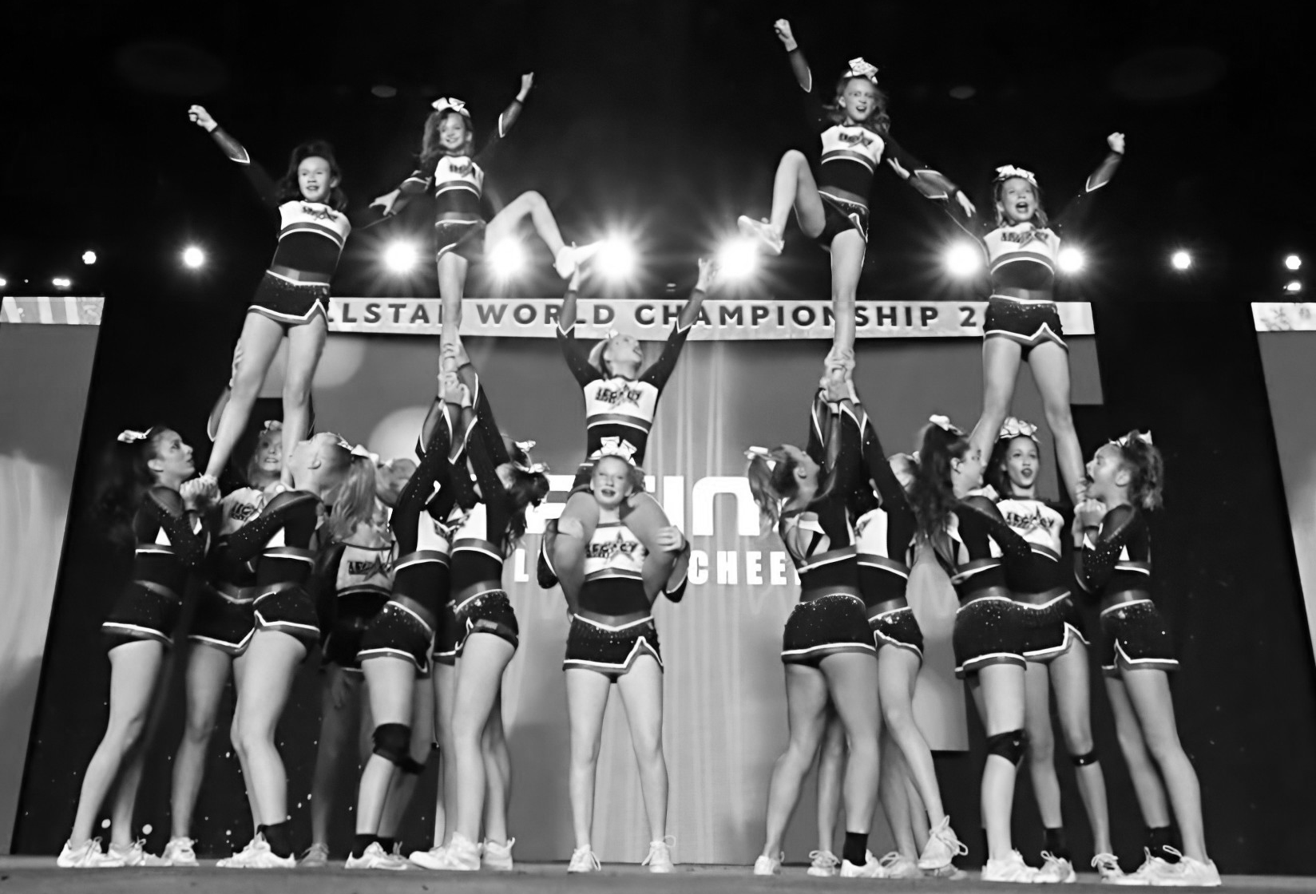
2025-2026 Legacy Class Coaches Manual

Slide 2
Legacy Cheer Summer Class Pass
In order to offer flexibility for families to travel in the summer, we will be offering Summer Class Passes. Our summer session will be June 2-August 8.
We will offer three different price points based on class passes.
  10 Class Passes- $250
  15 Class Passes- $325
  Unlimited Class Pass- $500
All Athletes not registered for an All Star team will need to pay the annual $50 registration fee.
There are three different levels that we want the girls to sign up for according to their tumbling skills
  Beginner- working on forward rolls, backward rolls, cartwheels, back bends, back bend kickovers, front walkovers, round offs and working back handsprings
  Intermediate- accomplished most of beginner skills including the back handspring. Working on standing and running back handsprings, series of back handsprings, front walkover to back handsprings, flysprings.
  Advanced- accomplished most of intermediate skills, including a back handspring series, standing series. Working on tucks and higher, including punch fronts, aerials, round off back handspring tucks, layouts, fulls, etc.

Slide 3
Legacy Cheer Summer Class Pass
Schedule- there will be at least one tumbling class per weekday offered at every level. We will also offer other skills classes.
  Flyer Flexibility and Strength
  Jumps
  Half Year Team tryout prep classes
  Sideline Cheer Classes
  Stunt Classes
Any specialty clinics or private lessons are NOT included in the class pass.
There will be no refunds for classes not taken.
Siblings can not share a class pass.
Clipboard at front desk with each level separate.
  Athlete will have the amount of classes they registered for.
  Athlete will mark each date of class taken
Each coach will tally the amount of kids in each class so we can reevaluate schedule in two weeks and put in spreadsheet.

Slide 4
Policies and Expectations
Please wear t-shirts or tank tops, but no crop tops or sports bras with shorts. Cheer tumblers wear shoes when they tumble. Hair in a ponytail. No Jewelry.
Stay in lobby or specified stretching area until coach comes to get you for practice.
Phones and backpacks to be left in lobby cubies. Water bottles may stay in the designated water bottle station. No food in gym area.
For Summer Session, there is no makeup policy and no passes carry over.
Always attend class, if class is very small, we might redistribute coaches, or eliminate a class for next week. Always check the google drive schedule for an updated schedule.
If no one shows, and you want to work hours for your time, we can always have you help another class/team, or do admin/facility work at the gym.
Each coach is RESPONSIBLE for finding a sub and it would be nice if you subbed for others.

Slide 5
2025-2026 General Guidelines
NEVER SIT AS A COACH!
  Parents view this as lazy.
  Be engaged with the athletes, walking around.
Athletes- not sitting more unless they’re stretching!
  My biggest complaint is parents saying their kid wasted practice.
  DIFFERENTIATION!
    Stations, conditioning, drills, mirroring, shadowing
Firm but kind! That’s my motto! Limit yelling, no shaming! Logical consequences, but not punishments
Injury Report Forms

Slide 6
Legacy Gym Opening
Opening the Gym-
Lockbox for key. Store code in a secure place.
Turn on lights- one light to gym in lobby, the rest are marked by X’s in the electrical box.
Check bathrooms- restock TP, soap, paper towels
Thermostats
  Lobby (2)- AC arrow down to comfortable, but not below 74, otherwise it’s scheduled
  Warehouse (3)- Hit “Mode” until cool, then hit “save,” then keep at 75
Enable iPad for attendance.
Any maintenance issues- call/text Michael Toney- 214-738-7309

Slide 7
Legacy Gym Closing
Closing the Gym
If mats need vacuuming, then vacuum.
Pick up any debris in gym.
Check bathrooms- restock TP, soap, paper towels, wipe down sinks.
  Lobby, offices, and bathrooms will be cleaned 1-2x per week.
Check Break Room- wipe down table and sink.
Take out trash if full or any food is in the trash cans. Replace trash bags.
Thermostats
  Lobby (2)- is automatically scheduled and doesn’t need to be adjusted.
  Warehouse (3)- Hit “Mode” until off, then hit “save.”
Turn off all lights- one light to gym in lobby, the rest are marked by X’s in the electrical box.
Lockbox for key. Store code in a secure place.
Any maintenance issues- call/text Michael Toney- 214-738-7309

