Slide 1


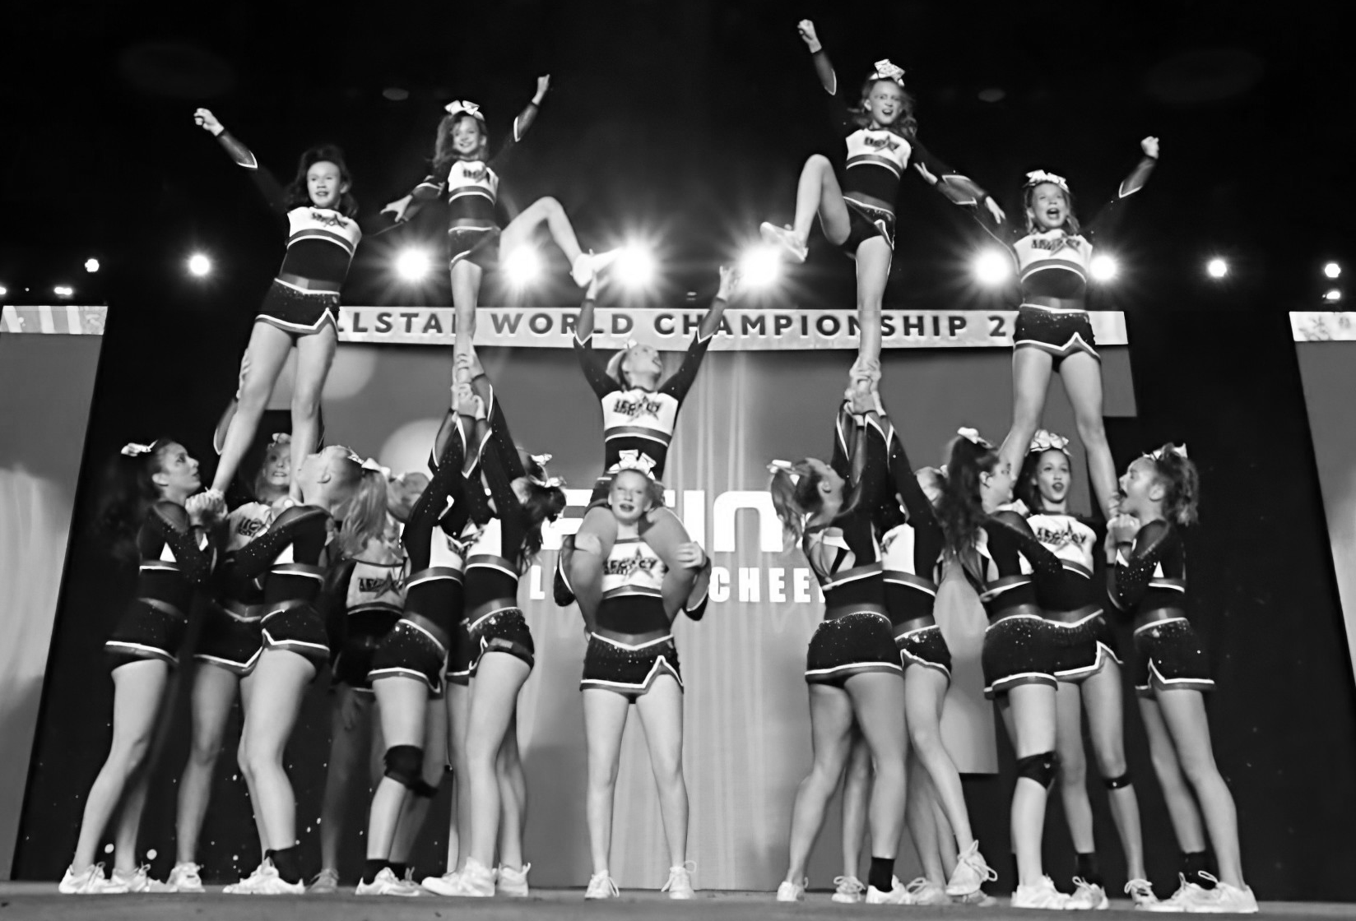
2025-2026 Half Year All Star Handbook

Slide 2
We continue to be in awe of the overwhelming interest in Christian All Star Cheerleading! All Star cheerleading is a competitive sport that requires commitment and dedication from both athletes and parents.
Legacy Cheer is excited to offer half year teams that start in September and run through February, while also expanding to tumbling and stunting classes, as well as birthday parties, camps, etc!
All our teams require commitment, dedication and perseverance. Please carefully consider the financial and time commitment that the teams expect before trying out. Depending on the skill level of the girls trying out will determine the team level.
Cheers!
Erika Toney
Legacy Cheer Owner and Coach
We will not hide these truths from our children: we will tell the next generation about the glorious deeds of the Lord, about his power and his mighty wonders. Psalms 78:4

Slide 3
Legacy Cheer Tryouts/Evaluations
Participation in the evaluation indicates that you trust the coaches to place your athlete on a team in the best interest of your athlete, the team, and the program. Your participation indicates that you are prepared to commit to the Legacy Cheer Program for the entire season.
Team placements will be determined by experience and confidence in skills. We will also consider age, maturity, work ethic, prior commitment level and teamwork.
If coaches determine that an athlete isn’t ready for a team, we will ask that she continue in our Skills classes.
Evaluation Fees- $30 before 8/1/25, and $40 after. If you can not attend the tryouts, you need to contact Legacycheerallstar@gmail.com to set up a private evaluation- $50 fee.
Half Year Team Evaluations in August
  Thursday, August 21
    4:30-5:30: Ages 5-8
    5:45-7:00: Ages 9+
  Friday, August 22
    4:30-5:30: Ages 5-8
    5:45-7:00: Ages 9+
  Sunday, August 24 from 2:00-3:15
    Potential call backs for SOME athletes to demonstrate stunting experience.

Slide 4
Legacy Cheer Programs
Programs:
Half Year Novice Teams: Evaluations in August. Season runs September – February (6 months), practice twice per week. 3 Competitions (all local) + Showcase, purchase uniform.
Half Year Show Teams: Beginner Teams: Evaluations in August. Season runs September – February (6 months), practice once per week. 2 Performances+ showcase (all local), purchases practice wear as uniform.

Slide 5
Legacy Novice Teams
*subject to changes based on registration numbers
Half Year Novice Teams
  Practice twice a week for 1.5 hours each.
  Choreography weekend
  T-shirt provided
  Practice wear required- new, approximately $120
  Uniform required- new ($240) or resale ($120)
  Will perform at Legacy Cheer Showcase on February 8
  Will compete at 3 local competitions team on January 17, January 24 and February 21. Competition fees included.
The Half Year Teams will have an annual fee split into six monthly payments. The first payment is due in August at the time of team announcement. The remaining 5 payments are due on the 5th of each month October 2025 through February 2026 and will be auto drafted. Monthly fee = $230

Slide 6
Show Teams
*subject to changes based on registration numbers
Half Year Teams- Show
  Practice once a week. 1-1.5 hours depending on age.
  T-shirt provided
  Uniform- Practice wear tank and skirt- $120
  Will perform at Legacy Cheer Showcase on February 8
  Will perform at two local competitions on January 24 and February 21.
The Half Year Teams will have a fee split into six monthly payments. The first payment is due in August at the time of team announcement. The remaining 5 payments are due on the 5th of each month October 2025 through February 2026 and will be auto drafted. Monthly fee = $180

Slide 7
LC Half Year Team Criteria
Level 1 Requirements
Required Tumbling- Front Walkover, Cartwheel, Back walkover connected.
Required Stunting- Prep Cradle, Braced Prep Lib (flyers demonstrate body positions), braced extension
Demonstrate a dance and three jumps.
There is room for a few girls that do not have the required tumbling/stunt skills if they demonstrate excellent skill in one of the other categories. For instance, for a team of 19, only 13 are required to have the elite tumbling skills.
Level 2 Requirements
Required Tumbling- Roundoff Back handspring (recommended series), Standing Back Handspring (recommended Back walkover back handspring)
Required Stunting- ½ up extension cradle, free standing prep lib (flyers demonstrate body position), Lib to Lib tick tok, braced liberty extension
Demonstrate a dance and three connected jumps
Straight ride basket tosses for Elite Level 2.
There is room for a few girls that do not have the required tumbling/stunt skills if they demonstrate excellent skill in one of the other categories. For instance, for a team of 19, only 13 are required to have the elite tumbling skills.

Slide 8
Levels within Levels
Within Levels 1-3 in Cheerleading there are other defining levels that are determined by experience and technique. Elite, All Star Rec, and Prep are divisions for our full year teams.
Novice- intended for girls ready for that level, but they are only judged on technique and not difficulty, so they are competing skills at the bottom range of that level. Routine duration is 1.5 minutes, and they are not allowed to compete basket tosses. They typically only compete on Saturday. Our novice teams will compete at all local competitions. NOVICE TEAMS DON’T COMPETE AGAINST OTHER TEAMS FOR 1ST. 2ND OR 3RD. THEY COMPETE FOR RATINGS OF SUPERIOR, EXCELLENT OR OUTSTANDING.
Show Teams- intended for beginners, but have a lot of flexibility! Don’t compete or get a scoresheet, just perform.

Slide 9
Policies and Expectations
½ Year teams will have 15-30 of tumbling Sept and Oct. Practice time must be used for the routine choreography.
We strongly recommend another tumbling class/or occasional private lessons.
No Jewelry. Wear the correct practice wear.
Payments are non-refundable, and will be auto-drafted on the 5th of every month.
You may choose a payment plan or pay in full. The payment plan will be on autodraft.
You must provide 30 days notice for cancellation, and if you cancel past September 30th, you will have to pay all competition fees.
Hair in a ponytail for practice.
Stay in lobby until coach comes to get you for practice.

Slide 10
Attendance Policies for Teams
ALL competitions are REQUIRED! If an athlete misses a competition for an unexcused reason, this could be grounds for dismissal.
School Year Attendance
  Excused Absences-sickness, family emergency or school functions that result in a grade, school cheer events with prior notification
  Each Athlete will be afforded 2 unexcused absences, but coaches still need prior notification.
    Other outside sports
    Birthday parties
    Fun events
    Cotillion
    NCL
    Other events
  3 or more unexcused absence, potential consequences at the discretion of the coaches.
    Required private lesson at parents’ expense
    Removal from stunt group, or parts of routine
    Removal from team
    Other consequences at discretion of coaches
If absences are in excess or the week of competition, we may need to find a replacement in the routine.

Slide 11
Agreement to Legacy Cheer Policies
I have read and agreed to the terms, conditions and policies set forth in the Legacy Cheer Program Packet. My daughter is available for the competition and showcase dates.
_______________________
Parent Signature
_______________________
Date
_______________________
Athlete Signature

Slide 12
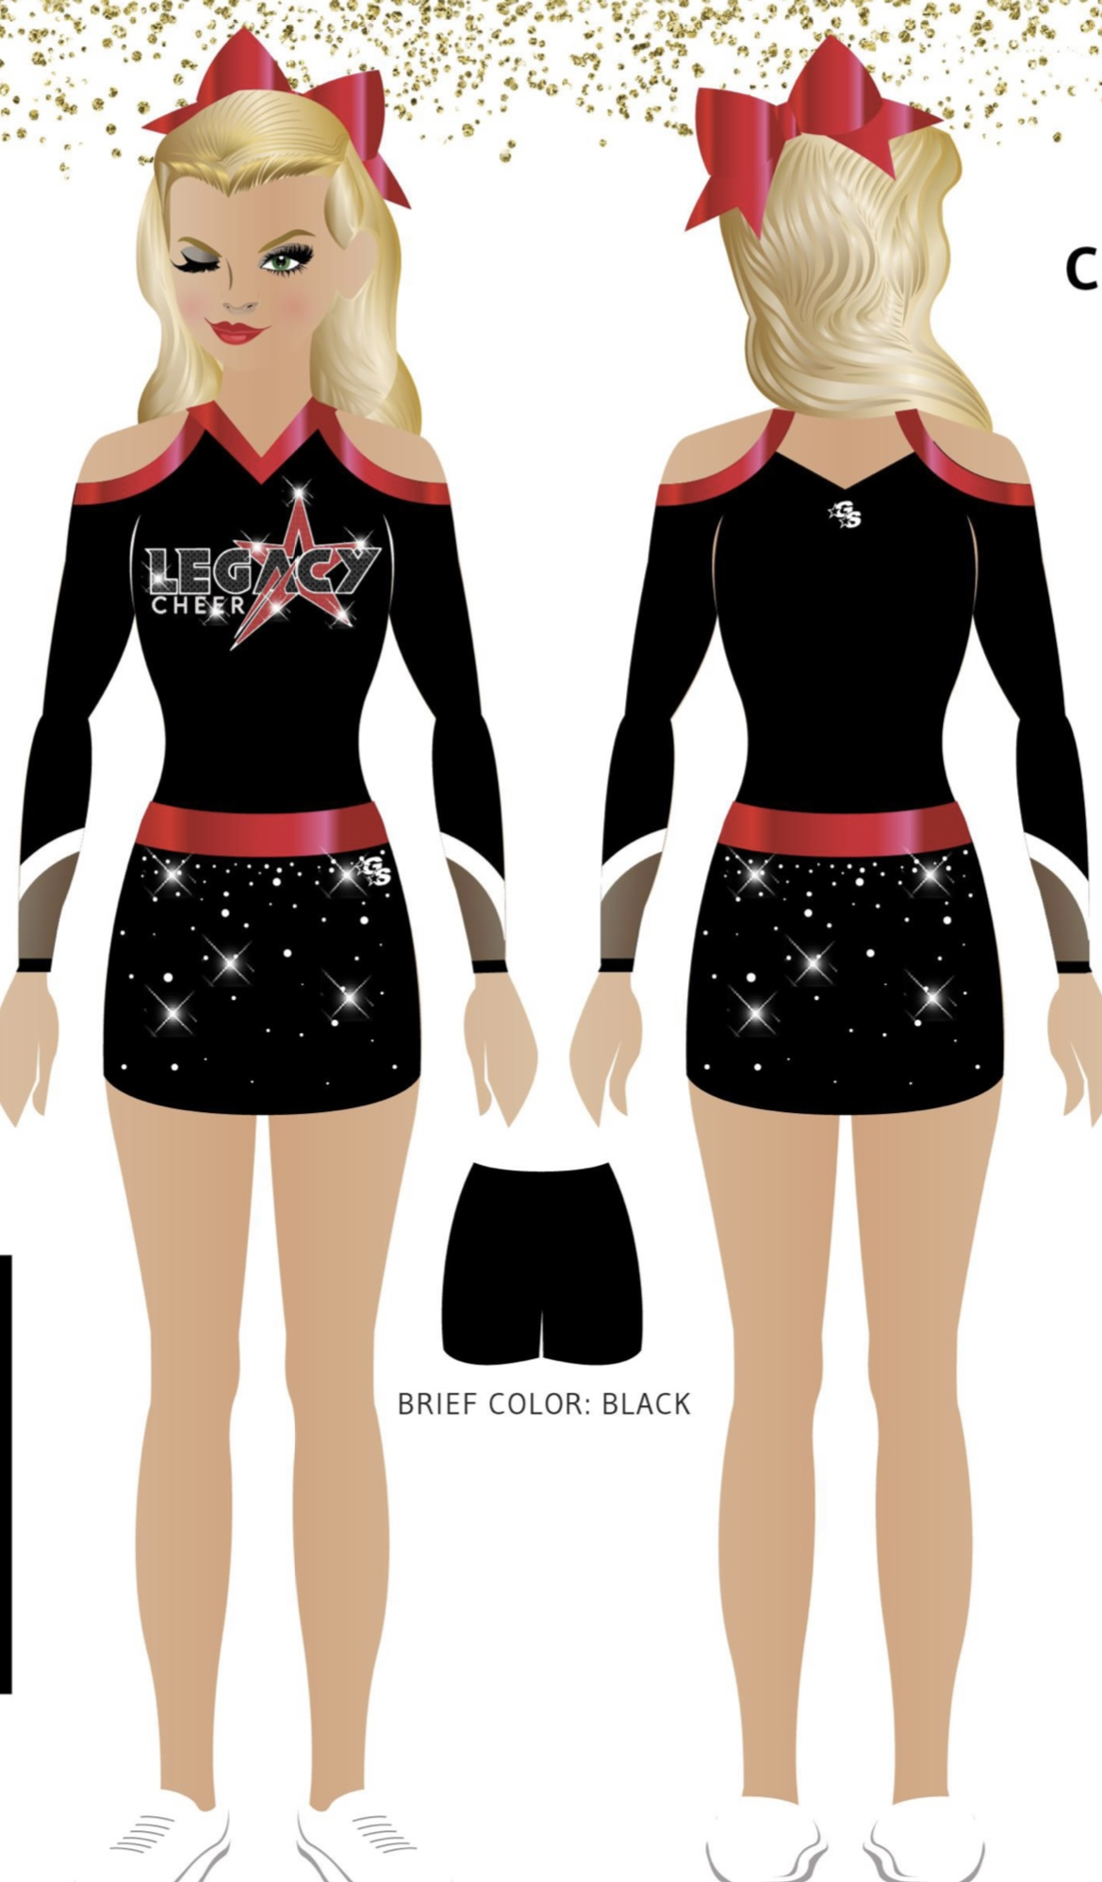
Novice Teams- $240 new, $120 resale

Slide 13
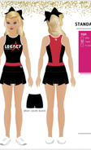
Novice Teams: Practice Wear
Show Teams: Uniform
$120

Slide 14


Optional Items

